Slide 1
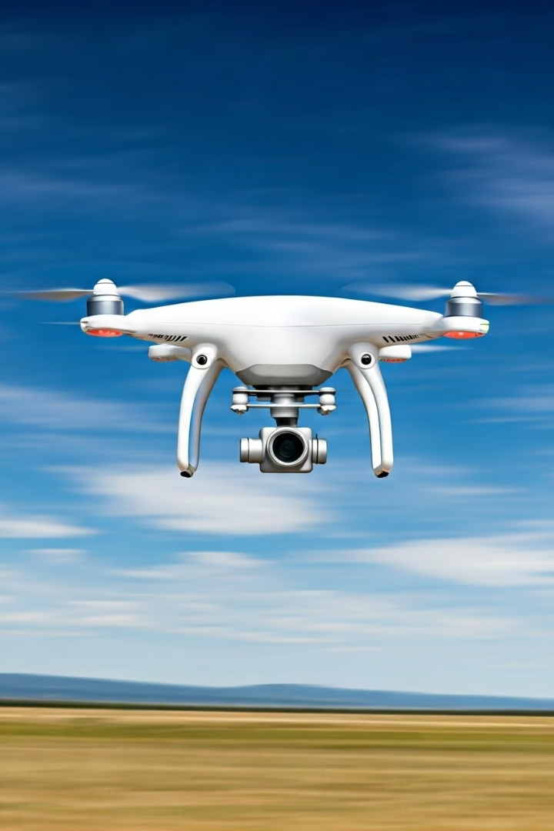




Aero.Next: Optimizing UAV Control for High-Speed Deployments
Author: Lorenzo Giordano
Advisor: Prof. Marco Lovera
Co-Advisor: Prof. Rodrigo Ventura, Prof. Meysam Basiri
Study on drone stabilization after deployment from fast-moving aircraft
This thesis work was funded by Aero.Next project (PRR—C645727867-00000066)

Slide 2

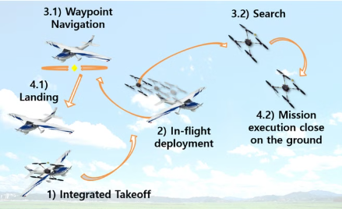
1
Multirotors UAVs
Problem:
Rapid deployment is needed
Advantages
The drones investigated in this study are Multirotors:
Versatility
Solution:
In-flight aerial deployment
Maneuverability
Ability to perform complex aerial operations
Limitations
Low Speed
Limited battery life
These constraints become particularly challenging in emergency response scenarios, such as natural disasters.

Slide 3
2
Problem Statement and Objectives
Objective 1
Develop robust control algorithms for post-deployment stabilization.
Main problem
Objective 2
Stabilize Drone after deployment from fast-moving aircraft.
Simulate real-world conditions for
Deployment.
Objective 3
Analyze and identify most efficient stabilization approach.

Slide 4
3
Content
Control Strategies
Gains Tuning
Simulation Environment and SetUp
Optimal Delay Assessment
Results

Slide 5
4
Control Strategies
1
Lee Geometric
Operates in the special Euclidean group SE(3)
Decoupling between Position and Attitude
2
Lee Evolution
Handle more complex situations → 180 degrees rotations
3
Sliding Mode
System (drone) to 'slide' towards stability
Sliding Surface: predefined path that the system follows to reach stability
4
Hybrid
Combines SMC and Lee
5
Gain-Scheduled
Two different sets of gains: uses Lee Evolution

Slide 6
5
Lee Geometric Control:
Strengths:
Decouples position and attitude control
Mathematically rigorous
Singularity-free control with SO(3)
Limitations:
Sensitive to model inaccuracies.
Slower to respond to large disturbances.
High computational requirements.
Evolved Lee Geometric Control:
Strengths:
Improved robustness
Handles large rotations
Faster stabilization.
Limitations:
Needs accurate system modeling.
Increased complexity and computational demand
Sliding Mode Control (SMC):
Strengths:
Highly robust
Fast response
Quick stabilization
Limitations:
Chattering (small vibrations)
Too aggressive control
Sliding surfaces.

Slide 7
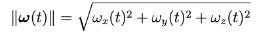
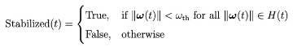
6
Hybrid Control Strategies: Combining Stability and Agility
Hybrid Control
Take advantage of both the control strategies
Gain-Scheduled Control:
Adaptive approach to handle different phases of flight
Same control strategy
Different sets of gains
1
Aggressive Stabilization
Rapid stabilization during aggressive maneuvers
Adaptive Transition
Monitoring
2
Smooth Hovering
Smooth and stable hovering
Smoothing Function

Slide 8
7
Content
Control Strategies
Gains Tuning
Simulation Environment and SetUp
Optimal Delay Assessment
Results

Slide 9
8
Gains Tuning - Brute Force
Gains ranges Definition
Gains Systematic adjustment
Gains evaluation based on performace metrics:
Overshoot
Settling Time
1
Strengths
Provides a complete mapping of the parameter space, ensuring that no potential solutions are missed.
2
Limitations
Computationally Expensive
Time-Consuming

Slide 10
9
Gains Tuning
1
2
SOLUTION
Need for a more efficient solution.
No insight for the SMC
Heuristic approaches

Slide 11
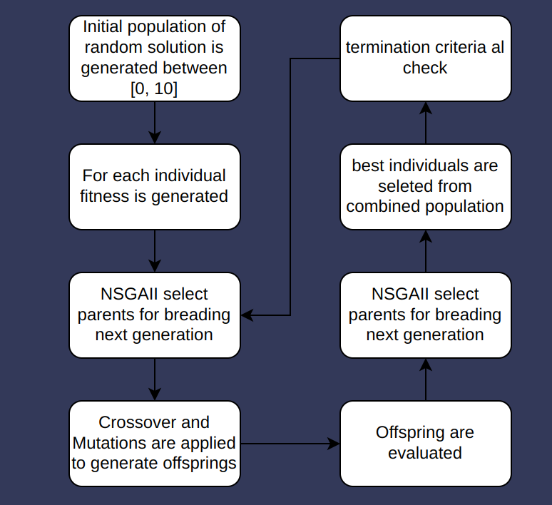
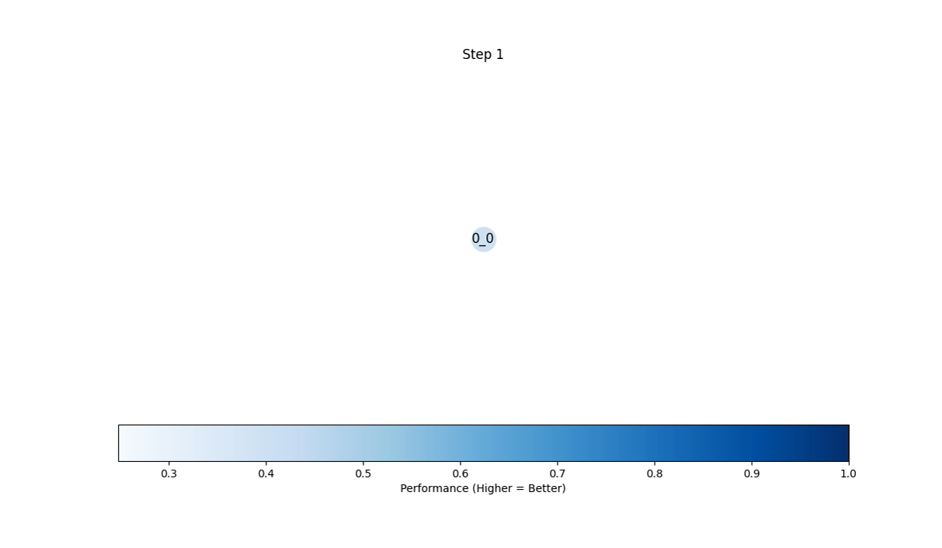
10
Gains Tuning - Genetic Algorithm
Inspired by natural selection
Multi-Objective Optimization

Slide 12
11
Gain Tuning - Strengths and Weaknesses of GA
Strengths
Weaknesses
Faster than Brute-Force
Computationally expensive
Converging in fewer iterations
No guarantee finding the global optimum
Intelligent search of the parameter space
Risk of premature convergence to local minimum
computational load reduction
Noisy fitness evaluation:
simulator instability
CPU constraints

Slide 13
13
Content
Control Strategies
Gains Tuning
Simulation Environment and SetUp
Optimal Delay Assessment
Results

Slide 14
14
Simulation Environment and Setup
RotorS Framework
1
The RotorS framework provides a realistic environment for simulating UAV dynamics, sensor models, and control algorithms.
2
ROS Integration
ROS nodes publish commands and subscribe to sensor data topics, monitoring the quadrotor's performance.
Ideal and Real Scenarios
3
Ideal scenarios assume perfect sensor readings, while real scenarios incorporate sensor noise and fusion using an Extended Kalman Filter (EKF).
4
Gazebo Integration
3D simulation tool used. Integrates with ROS to simulate realistic physics

Slide 15
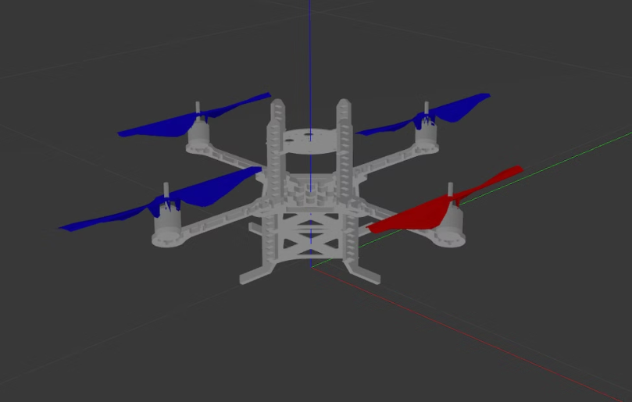
15
Experimental Setup
Quadcopter
AscTec Pelican
Deployment Height
200m
Initial Velocity
60 knots (108 km/h) along the x axes.
Rotational Velocities
25 rad/s ~ 239 rpm along x, y, z axes.
Wind Conditions
Up to 8 m/s with westward gusts.

Slide 16
16
Content
Control Strategies
Gains Tuning
Simulation Environment and SetUp
Optimal Delay Assessment
Results

Slide 17
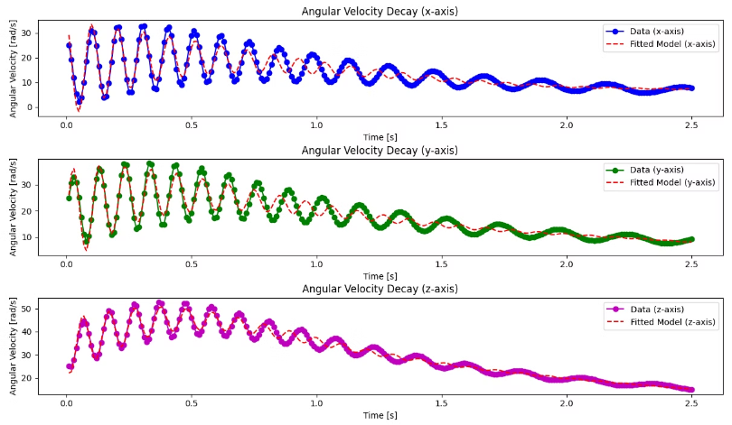
17
Optimal Delay - Assessment for Controller Activation
Goal:
Control Effort Reduction
Analyze the natural decay of oscillations
Lyapunov stability analysis
confirmed the inherent stability of the quadcopter’s dynamics
Damped Oscillation Data Analysis
Model fitting of damped oscillation data provided insights into the system's damping coefficients and time constants.

Slide 18
18
Content
Control Strategies
Gains Tuning
Simulation Environment and SetUp
Optimal Delay Assessment
Results

Slide 19
19
Control Performance Comparison
Controller
Ideal Scenario
Real Scenario
Lee Base
Slow, smooth
Failed to stabilize
Lee Evolution
Excellent stability
Robust performance
SMC
Rapid initial reduction
Persistent oscillations
Hybrid
Fast stabilization
Oscillations worsened
Gain-Scheduled
Best overall
Most effective

Slide 20
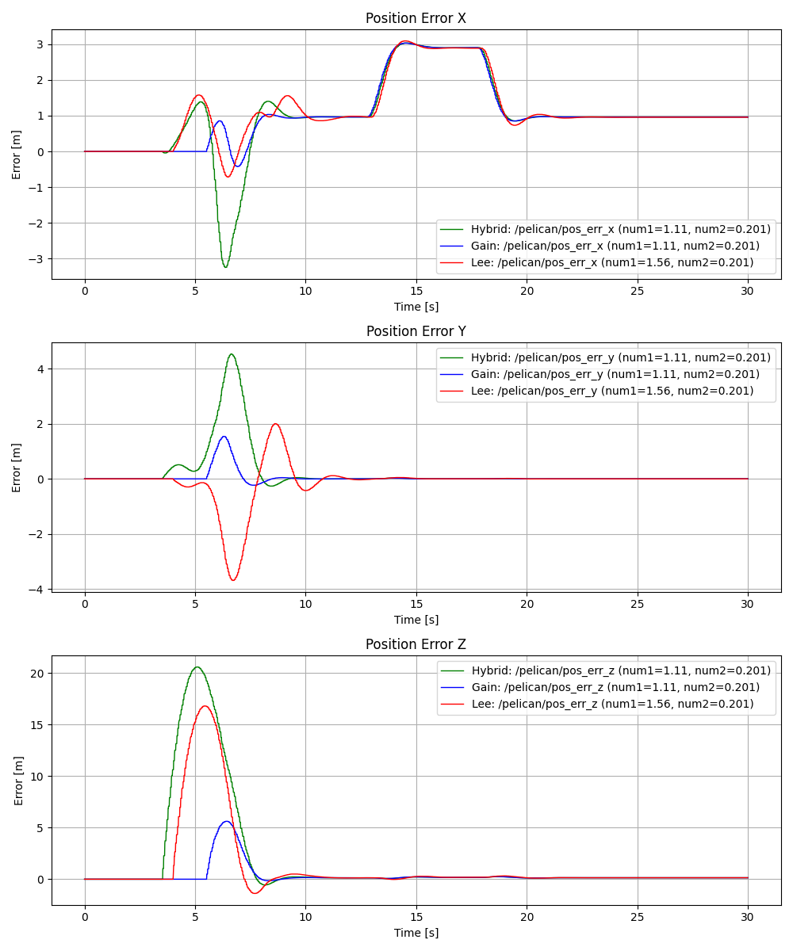
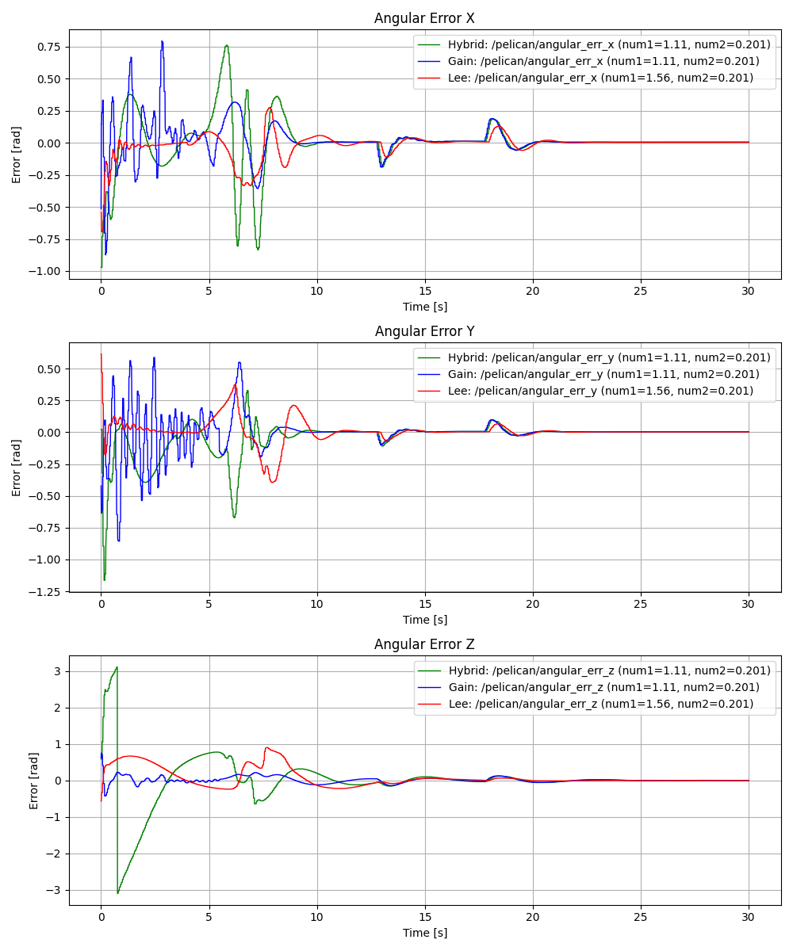
20
Controller comparison Ideal Scenario

Slide 21
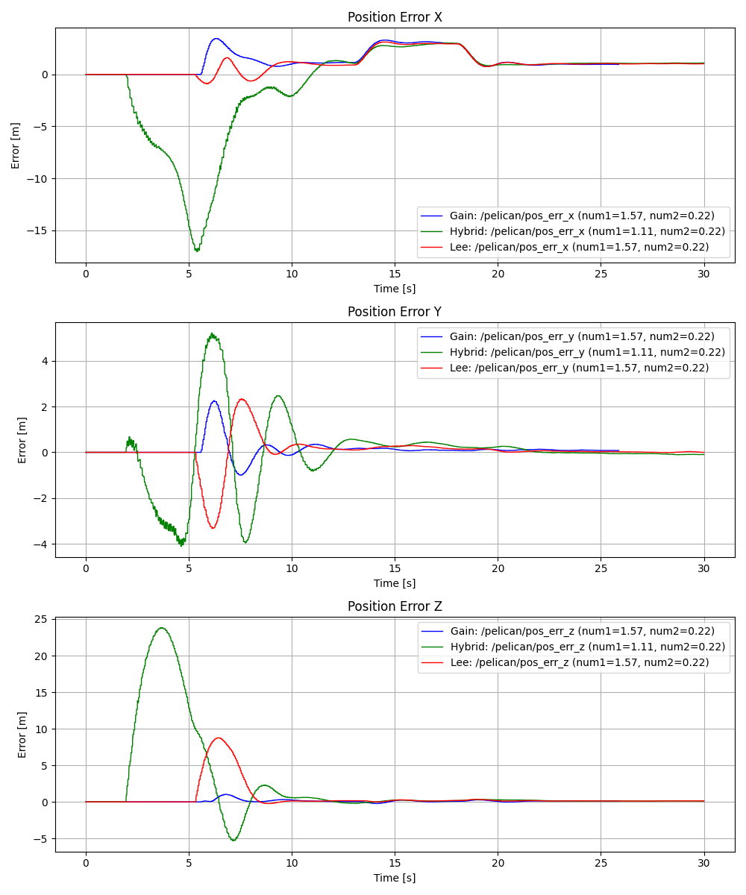
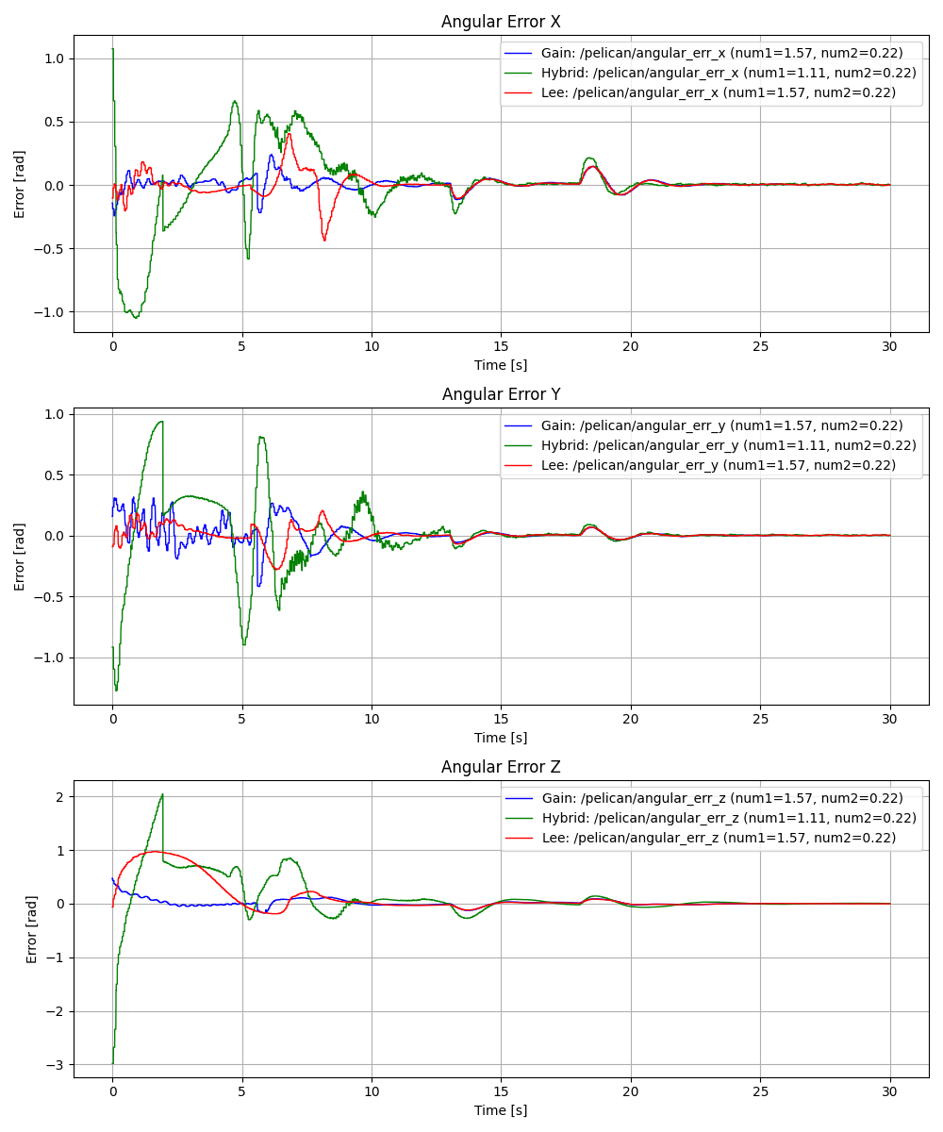
21
Controller comparison Real Scenario

Slide 22
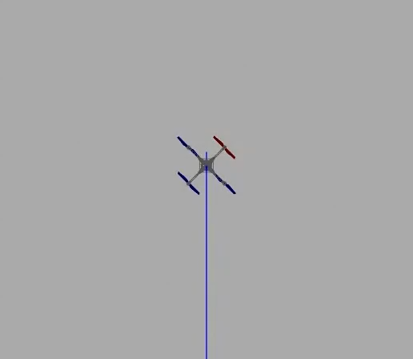
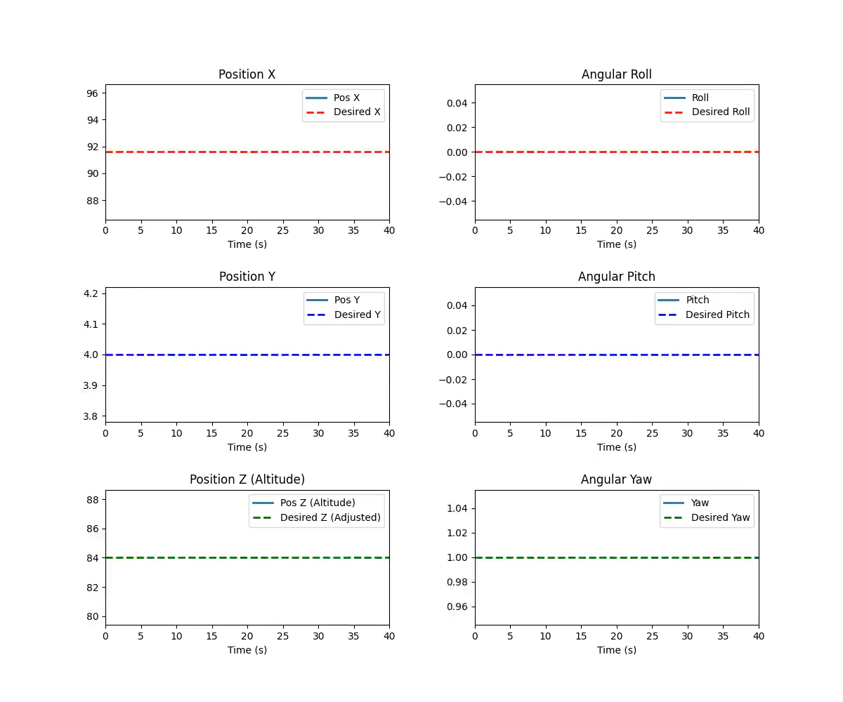
22
Gain Scheduled Ideal Scenario

Slide 23
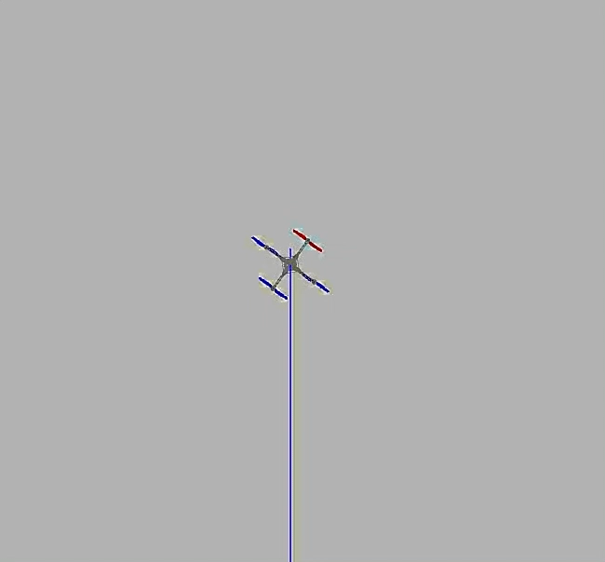
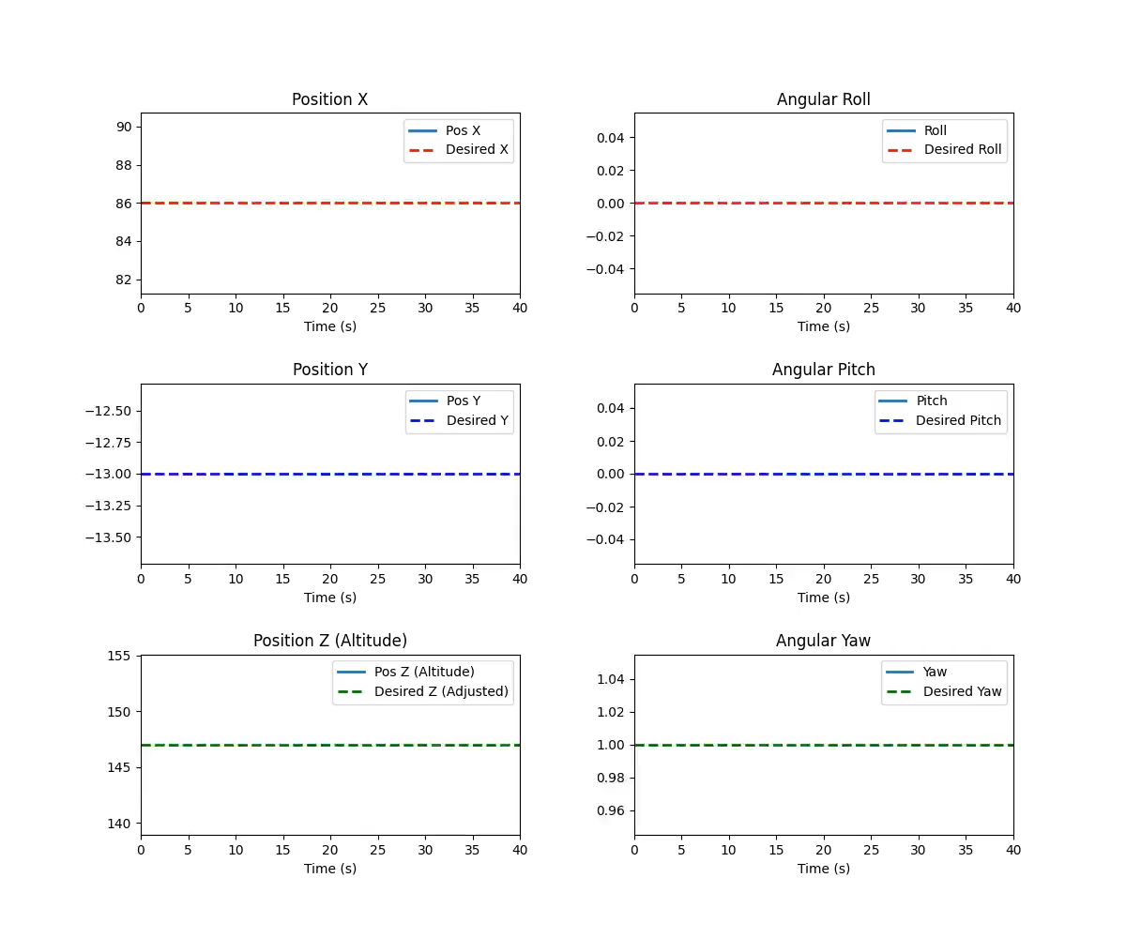
23
Gain Scheduled Real Scenario

Slide 24
24
Conclusion
Future Work
The use of heuristic approaches like the Genetic Algorithm (GA) proved effective for optimizing control strategies, providing better results than brute-force tuning while managing the complexity of the system.
1
Further Tuning of SMC: Refining the Sliding Mode Control for better long-term performance.
1
Gain-Scheduled Controller emerged as the most adaptable and effective solution, excelling in both rapid stabilization and long-term stability across both ideal and real scenarios.
Hardware Testing: Implementing and validating the results on real-world UAV hardware for practical applications.
2
2
Lee Evolution Control also performed exceptionally well, especially in maintaining stability with minimal oscillations, making it highly reliable for real-world applications.
Testing with Different Heuristic Algorithms: Investigating faster convergence and better results using methods like
Artificial Bee Colony (ABC)
3
3

Slide 25
THANKS FOR THE ATTENTION

Slide 26
APPENDIX

Slide 27
NSGA-II and Multi-Objective Optimization:
Handles multiple conflicting objects optimization
Non-Dominated Sorting:
Sorts the population into Pareto-optimal fronts
Individuals in the first front are non-dominated
no single solution dominates the others, preserving a set of optimal trade-offs
Crowding Distance:
to maintain diversity in the population
encourage solutions that are spread out across the objective space
avoids the risk of converging to a narrow set of similar solutions.
Elitism:
the best individuals (those closest to the Pareto-optimal front) are retained in the population across generations
continual progress toward better solutions.

Slide 28
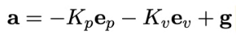
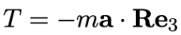
Lee Geometric Control
Basic Lee Geometric Control
The Lee Geometric Control (Base) is a control strategy for quadrotor UAVs that operates in the special Euclidean group SE(3), which governs both position and orientation in three-dimensional space.
1
Position Control Law
The position control law generates desired acceleration based on position and velocity errors. It incorporates proportional and derivative gains (Kp and Kv) to ensure smooth trajectory tracking while compensating for gravity.
2
Attitude Control Law
The attitude control law ensures alignment with the desired thrust direction. It uses attitude and angular velocity errors (eR and eΩ) to compute the required torque, considering the inertia matrix and gyroscopic effects.

Slide 29
Lee Evolution Control
Modifications to the original Lee controller to improve its handling of large rotational discrepancies, in particular 180-degree rotations.
1
Enhanced Robustness
This evolution addresses limitations in the base controller, that, when performing large rotations, experiences slow convergence and possible instabilities, due to the non-uniqueness of the rotation representation in SO(3)
2
A new attitude error metric and error function provide smoother convergence for aggressive maneuvers, resulting in faster stabilization and increased agility.

Slide 30
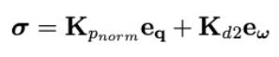
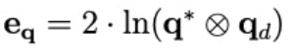
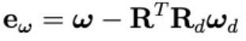
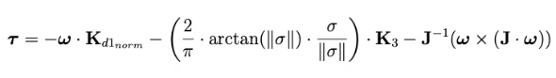
Quaternion Based Sliding Mode Control
Sliding Mode Control (SMC) introduces a robust control method capable of handling nonlinearities, uncertainties, and external disturbances. The core of SMC is the Attitude Control Law, with the sliding surface σ, which combines quaternion-based attitude error and angular velocity error. This surface acts as a reference for the system's desired behavior, driving the system's state to itself and maintains it there
1
Sliding Surface Definition
2
Chattering Mitigation
The chattering effect, common in classical SMC, is mitigated using a continuous control law. This approach uses a tangent function to smooth the control input, reducing high-frequency oscillations.
error definition:

